Slide 1
Ask Me Anything

Slide 2
Announcements/Reminders
No Class Weds/Thur/Fri – NO OH, Labs, little Ed Help
Most OH remote tomorrow

Slide 3
Join Ed
https://eecs.link/ed -- EECS 101 Ed
https://eecs.link/data-ed DATA 001 Ed

Slide 4
(Serious-ish) Ed Questions

Slide 5
Question
when were you first exposed to cs? how did you know cs is what you wanted to pursue?

Slide 6
Question
What pieces of advice/tips do you have for finding hands-on experiences beyond C88C to apply what we've learned into the industry and into practice, especially at and beyond Berkeley?

Slide 7
Question
As a freshman majoring in Data Science, what are some of the next steps I can take (beyond just taking the required classes for the major) to keep exploring various resources here at Berkeley? Any good places you recommend starting?

Slide 8
Question
If we want to pursue further study in the field of deep learning in the future, to what extent do you think math ability should be cultivated? I am taking eecs127 this semester, and want to know what other math knowledge besides the most basic math class can help us more.

Slide 9
Question
when can I start looking for internship? after which course? I feel like cs88 wouldn't prepare me for the job yet

Slide 10
Question
Do you have any information or advice regarding the process of switching into a high demand major like computer science or data science?

Slide 11
Question
Can the last question of the final exam be an extra credit question?
(or draw some patterns to earn points... :D)
does the ant in the CS88 logo have a name? if not, shall we name the creature now? :D 🐜 🐜

Slide 12
Question
do you have any cool ideas for personal projects students could pursue?? not hard-cs based but around the datasci cogsci realm. I'm getting the urge to channel my passions and perspectives so far into something for my resume, but it's so hard to know where to start!

Slide 13
Question
I didn't do too well on the midterms because I didn't finish it. :( What are some tips do you have for improving and doing better on the final?
Didn't do well on the first question of the midterm, how do we tackle a ton of imbedded lists like that?

Slide 14
Question

Slide 15
Question

Slide 16
Fun Ed Questions

Slide 17
Question
what fun things should we do before graduating from Berkeley?!

Slide 18
Question
hypothetically, how many geese do you think you could beat in a fight

Slide 19
Question
can you juggle for us :D

Slide 20
Question
What is the largest amount of chicken nuggets you're willing to eat in one sitting? :0

Slide 21
Question
Are there going to be data c88c stickers? :'D

Slide 22
Question
do you have any show, movie, podacst, music, or book recs? :)

Slide 23
Question
what advice would you have given to your undergrad self today?

Slide 24
Question

Slide 25
Question

Slide 26
(Un)solicited Advice

Slide 27
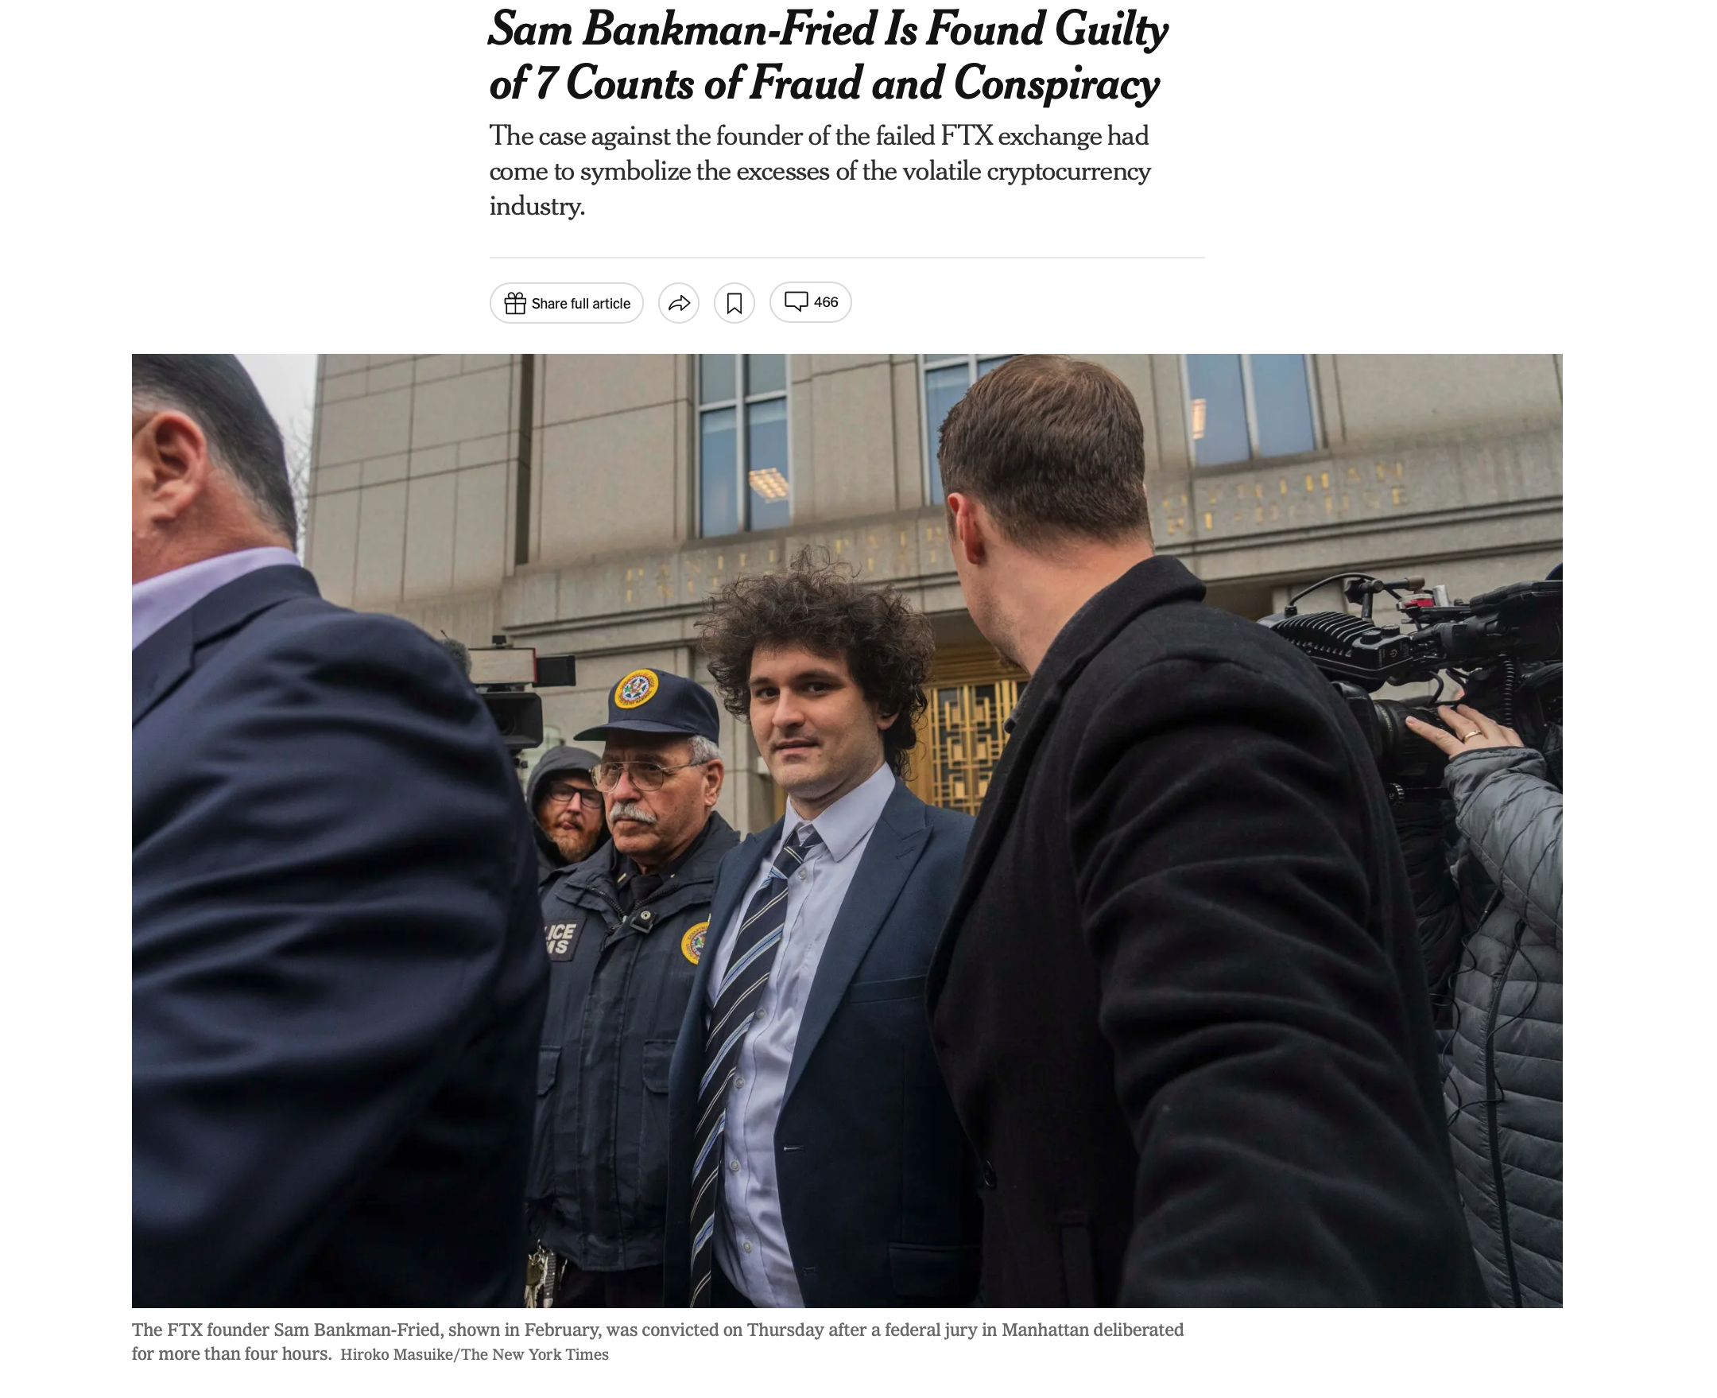
FTX / Careers / Power [NYT]

Slide 28
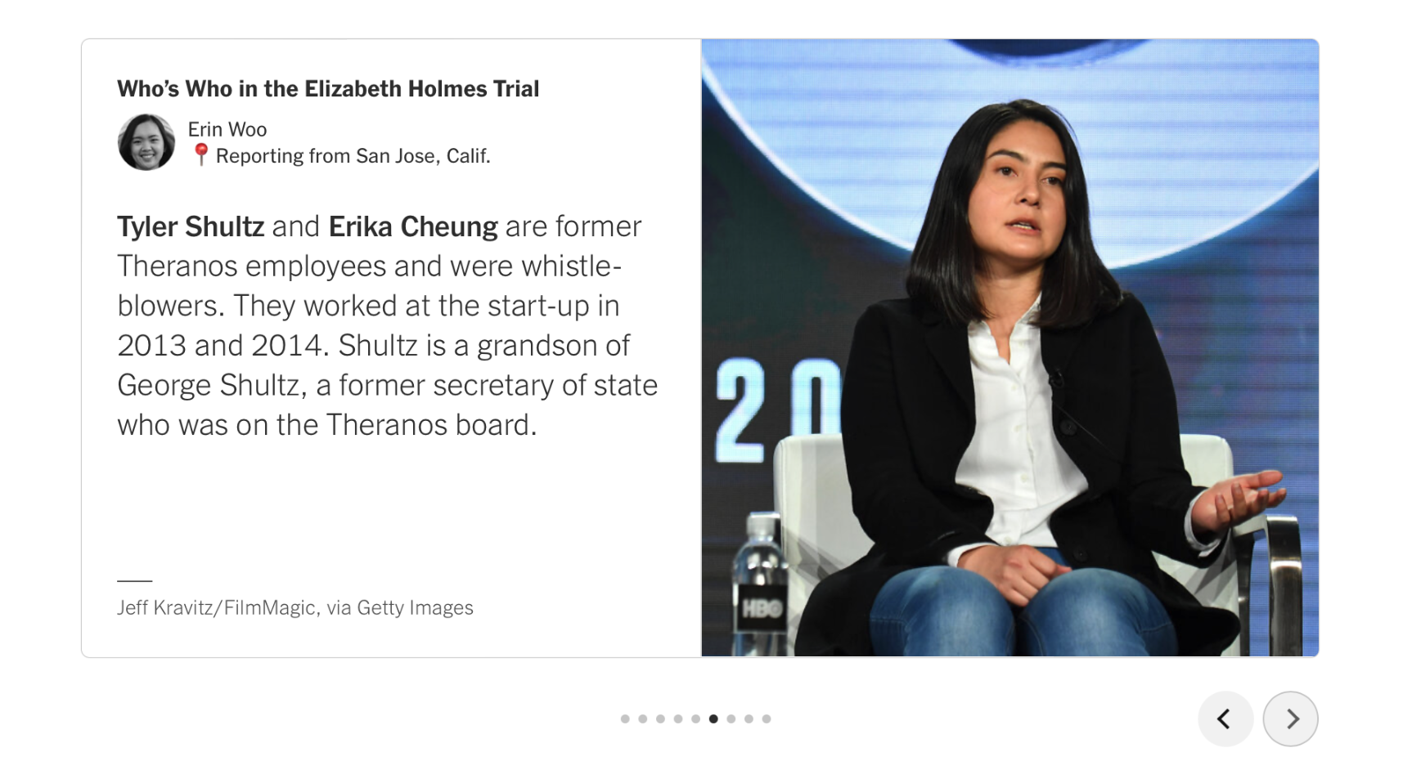
Other Corporate Scandals… Bears doing Good [NYT]

Slide 29
Question

Slide 30
Question

Slide 31
Question

Slide 32
Question

Slide 33
can you give us words of encouragement (life/school/career advice)? :'')

Slide 34
Anything Else?

